Slide 1
BASH 2014 WORKSHOP 1: Intro to Scala

Slide 2
In this workshop we’ll work through a set of samples and exercises to introduce the Scala language and standard library. Some Java (or similar) programming experience is assumed, but you don’t need to have done any Functional Programming before.
We’ll be using the Scala IDE:
http://scala-ide.org/download/sdk.html
Notes:
Format:
1) a few intro slides
2) I'll show some Scala code, and explain it.
3) Then I'll give you an exercise to try for a few minutes (try and make these follow on from /build on each other?)
4) I'll show my version, and we'll discuss it
5) Repeat 1 to 4

Slide 3
Ask The Audience…
Notes:
Show of hands:
- who's used Java? (any who haven't - what have you used)
- who's used Scala - how much? (read about it, written some, used it in-depth, code in production, expert)
- does everyone have the IDE installed?

Slide 4


Java Language
Scala Language
Java Standard Library
Scala Std Lib
JavaStd Lib
Java Compiler
JVM
Scala Compiler
JVM
Notes:
What's the problem with Java (or similar)?
- What's good about JVM and libs: ubiquity, easy to read, ecosystem of tools, libs, knowledge, JRE/JIT is fast, reliable, well-proven… workhorse
- What's not so good: Boilerplate, legacy gunk?, Not very expressive/powerful language, some things that should be easy feel hard…
Where does Scala come in?
- Platform: Lang, libs, JVM
- Scala replaces lang & compiler + and adds it's own std lib
- Less time typing, more time thinking!
Function OO hybrid
Succint - less boilerplate
Type System
Immutablility
thread-safety & parallelism
testability
referential transparency / purity
easier to reason about
no need for defensive copies

Slide 5
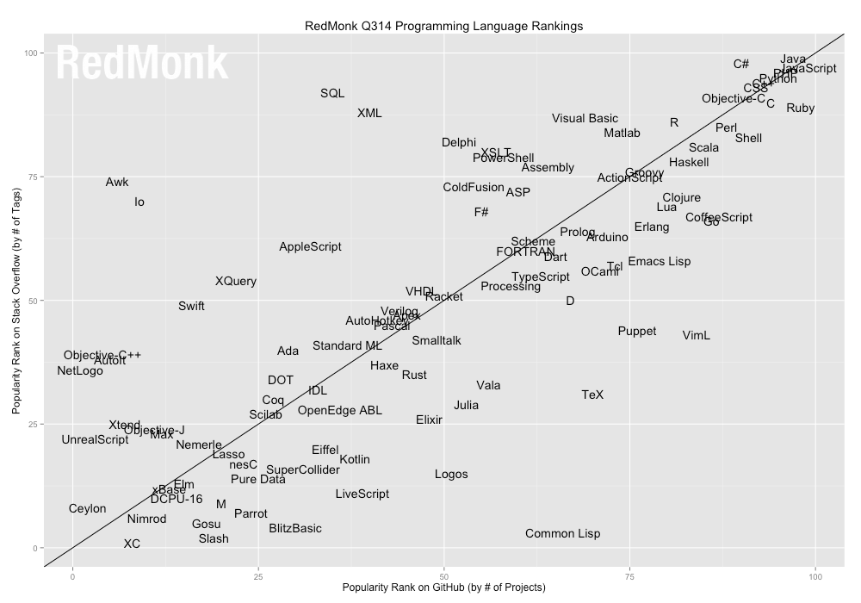
The mainstream

Slide 6
Examples & Exercises…
Notes:
Getting started:
Launch IDE.
File, New… Scala Project
Call it intro_workshop or similar and hit Finish to accept defaults
Open project, menu -> new scala worksheet
Call it ex1 and hit finish
Explain that this is a scratchpad for trying out snippets of Scala. Save to execute
Change default println string to test.

Slide 7
Exercise 1: Write a function to compare the length of two strings, and return true if the 1st is longer
Notes:
Scala. You will encounter a fundamental difference between Scala and other programming languages. In Java or C++, we differentiate between expressions (such as 3 + 4) and statements (for example, an if statement). An expression has a value; a statement carries out an action. In Scala, almost all constructs have values. This feature can make programs more concise and easier to read.

Slide 8
Exercise 2: Write a class to represent a Cuboid, with a volume method

Slide 9
Exercise 3: Create a list containing the odd numbers from 1 to 25, with those divisible by 5 replaced with “fizz”
Notes:
in a majority of situations, you only need to pick between a Map, Set, List, ArrayBuffer or a Vector.
if you need key-value lookup, use a Map
if you need to check for presence of elements, use a Set
if you need to store elements and traverse them, use a List or an ArrayBuffer
if you don't need a persistent collection, but random access is really important, use ArrayBuffer
if you need relatively fast random access and persistent sequences, use Vector

Slide 10
Exercise 4: Write a pattern matching function that given a
small Cube returns its volume
large Cube throws an exception
Circle returns its area

Slide 11
Exercise 5: Write a function that given the file name of a CSV file, loads its contents and returns the sum of the 2nd ‘column’.

Slide 12
Exercise 6: Write a function that returns the head & the sum of a List[Option[Int]]
def headAndSum(is:List[Option[Int]]) =
Notes:
● Option instead of null to represent
absence of a return.
● Option is not an error reporting
mechanism

Slide 13
Exercise 7: Write a function to find the price of the most expensive CD in the catalog at http://www.w3schools.com/xml/cd_catalog.xml
Can the return type account for a possible Failure (e.g. network)

Slide 14
Exercise n:
Create domain classes:
Person (name, age)
Item(stockcode, value)
Address(street, number, postcode)
Order(person, items, address)
Write a function to create some test data
Then write a function to find the average value of adult’s purchases grouped by postcode (i.e. an average for each postcode)
Notes:
~220 lines of Java across 5 files
~40 lines of Scala in 1 file

Slide 15
Summary
val, var, functions, expressions
Classes (including case classes)
Collections, Higher Order Functions, Lambdas
Pattern Matching & Exceptions
String & File processing
Tuples & Options
Error handling & XML
Notes:
Pain points
compile times
complexity
backwards compatibility
lots of ways to do things

Slide 16
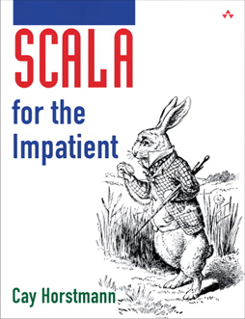
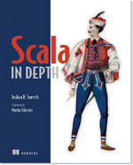
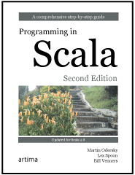

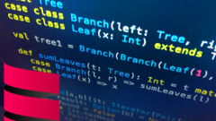

Resources
Notes:
Books: Scala for the Impatient, Scala In Depth, Programming in Scala
Online: Twitter Scala School, Functional Programming Principles in Scala (Coursera), Principles of Reactive Programming ( Coursera)

Slide 17
